Slide 1
Workflow API and workflow services
Boris Milašinović
Faculty of Electrical Engineering and Computing University of Zagreb, Croatia
A case study of biodiversity analysis using Windows Workflow Foundation
Software Engineering: Computer Science Education and Research Cooperation 13th Workshop, Bansko, Bulgaria, August 25 –September 1, 2013

Slide 2
What is workflow?
The automation of a business process, in whole or part, during which documents, information or tasks are passed from one participant to another for action, according to a set of procedural rules.
[Workflow Management Coalition, Terminology & Glossary, Document Number WFMC-TC-1011]
Why workflow?
Not (only) coding activities but orchestrating them and gluing together
Usually people associate workflows with
big automated systems
various document management systems with many users
various BPM tools
But… nothing of that in this case study ☺

Slide 3
Case study context - simplified description
Input:
geocoded findings of floristic species filtered according to various (and in future expandable) filters
an ESRI GIS layer: shape file with polygons and dbf file with additional information (attributes) for each polygon
Calculation:
Determine which findings belong to which polygon
Calculate biodiversity and ecological niche for a polygon and/or set of polygons having same attribute value
Output:
Create new dbf file extended with calculated data
Create result matrices (ecological niche, biodiversity data, taxa data, additional data...)

Slide 4
Biodiversity and ecological niche analysis
Ecological niche analysis
Species distribution - find in how many polygons (of the same GIS attribute) a species is present
Biodiversity analysis
α – diversity: number of different species in an area
Research intensity: Number of findings of each finding source per spatial unit (single polygon and/or GIS attribute consisting of multiple polygons)
Categories data
F(p, V) = N where V is one of possible values in a category (e.g. an ecological index) => N species in polygon p have value V

Slide 5
Why Workflow?
Visualizing the code
Frequent changes of order during development
Especially hard when parts of code are run in parallel => drag & drop
Result set depends on user’s permission and input criteria
many (hard to read) if-else/switch parts of code => flowchart
Logging, benchmarking, robustness
Try-catch blocks with stopwatch/log code before and after => composite activities
Continuation depends on an activity success/failure
Activities with many input and output arguments
using C# out/ref for parameters?
many new classes used only once?
Layering application

Slide 6
Why Windows Workflow Foundation?
Choosing one (from too many others) that easily plugs into environment and existing code
Windows Workflow Foundation (WF)
workflow engine and API integrated in .NET
differs from BPM tools as it is not intended for automatic form design
main purpose is control flow: sequential workflows, flowcharts and state machines
easily used from an application or exposed as a web service
workflow stored in xaml file (except code of custom activities) and designed inside Visual Studio

Slide 7
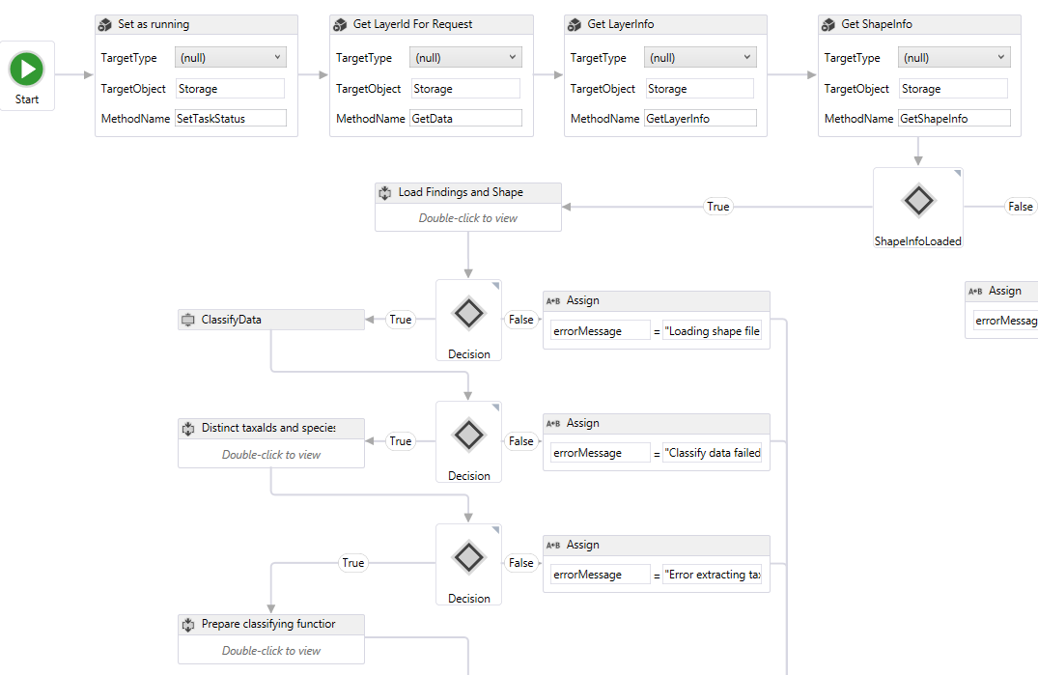
An excerpt from the workflow (1)

Slide 8
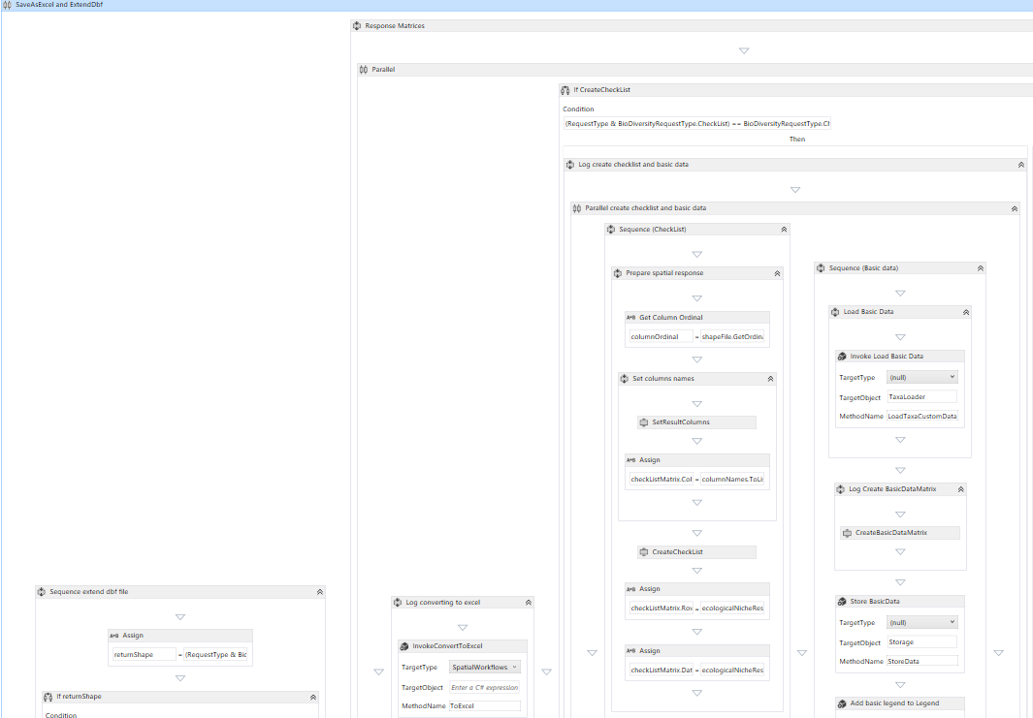
An excerpt from the workflow (2)

Slide 9
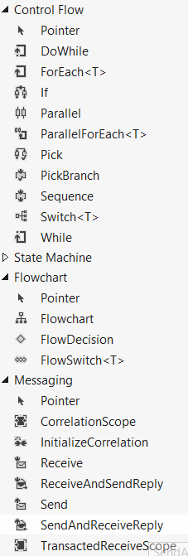
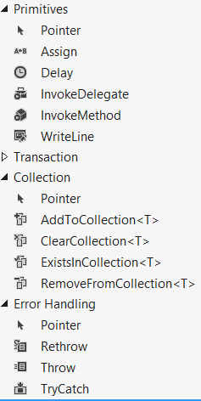
Workflow Activities
built in activities
custom ones
simple sequential activities (extending CodeActivity)
long running activities (AsyncCodeActivity)
complex activities (NativeActivity) - e.g. composite activities
combination of existing ones (mini-workflow)
each activitiy have Input/Output arguments
workflow has own variables

Slide 10
What have been done
Core GIS calculation extracted to separate library referenced by the workflow project
Workflow project contains
Composite activity for logging and benchmarking + try/catch
10-15 rather simple custom activities (20-100 lines of code)
A few custom activities designed as mini workflows consisting of built-in activities and custom ones
2 main workflows:
EcologicalNiche.xaml
BioDiversityWorkflow.xaml
Used in a separate workflow (web) service project
can be used from an application if needed

Slide 11
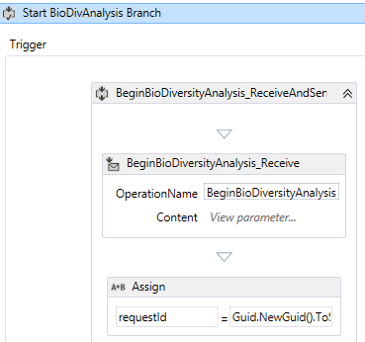
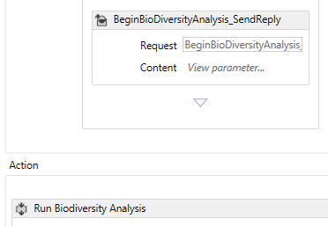
Exposing workflow as a web service
Precisely WCF service so does not need to be HTTP(S) protocol
WCF service contract shared or WSDL can be generated
PickActivity with many branches
Branches wait for invocation of a method from WCF service
start new instance or continues an existing one
common (initial) code before PickActivity executed every time new instance is created
Trigger – Action pattern
Trigger: receive and send response
Action: run after response
…

Slide 12
Problems
Not so easy to learn WF and some initial effort is needed to become familiar with the tool
Demanding GUI (relatively fast computer needed)
Rectangular design, quite large and wide, not printable
Declarative code
Error in xaml can cause visual design to fail
Error descriptions and debugging not so clear like in „normal” code
Dependency graph not correct if project referenced only in xaml
Refactoring is painful
changing activity name, namespace or parameter name does not make changes in xaml file
Removing a parameter from a custom activity does not update xaml file – changes have to be done manually in xaml file

Slide 13
Conclusion
WF (or similar workflow engine) is very useful
Visualize a process
Helps layering application
Offers easy use from an application or advanced scenarios with web services
Enables flowchart design
Ease changing order of a execution (drag & drop and visual design)
Activities are well defined with input/output parameters and easy to test
… but still have some teething troubles
…but (in personal opinion) have bright future

